Slide 1
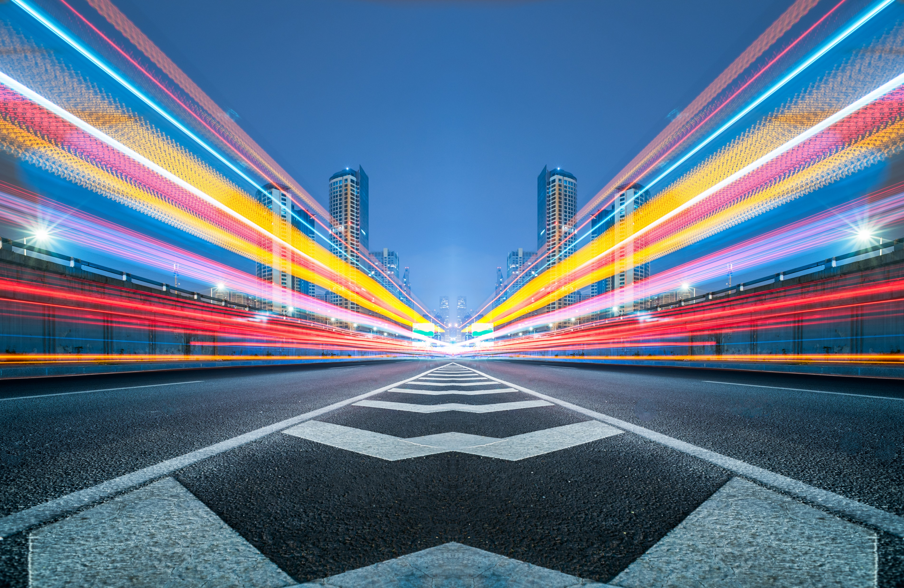


Slide 2


Slide 3
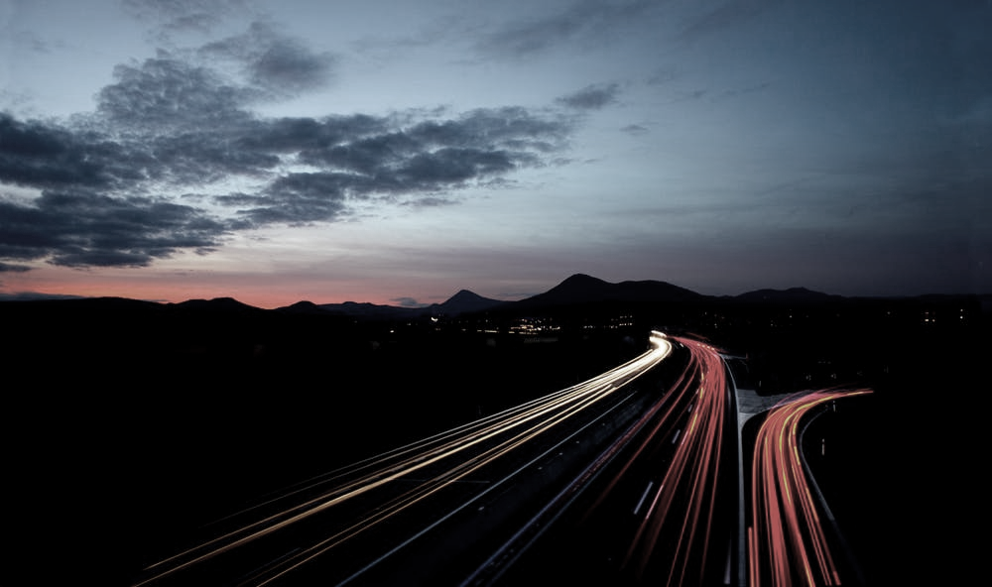
the Problem

Slide 4



Blue Ocean Strategy
Unique Solution
Minimal competition
Impact more people

Slide 5
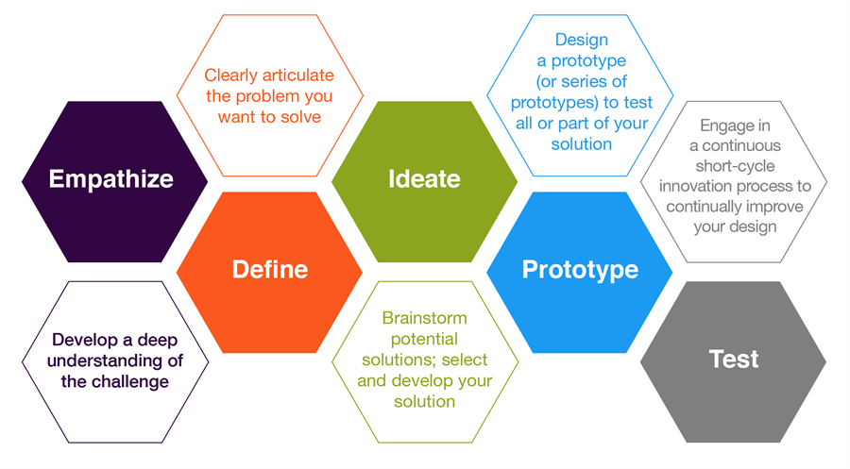
Design Thinking Process

Slide 6
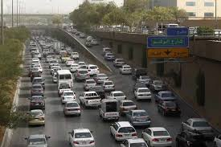
Traffic Problem – Jeddah City
Problem 1 Problem 2 Problem 3 Problem 4
PEAK CONGESTION: MORNING: 26% OR 17Min. Per hr.
EVENING: 37% or 22Min. Per hr.
Ref.: TOMTOM STATISTICS
JEDDAH TRAFFIC INDEX RANK: 272
rRef: WORLD BANK 2018 REPORT
LAND ALLOCATED FOR ROADS: 23% -
MODERATELY WEAK, HENCE CONGESTION ON STREETS
TRAFFIC FATALITIES:
17 PER 100K, OR 765/ YEAR
Ref: JEDDAH CITY PROSPERITY INDEX REPORT 2018, MOMRA,
KSA

Slide 7
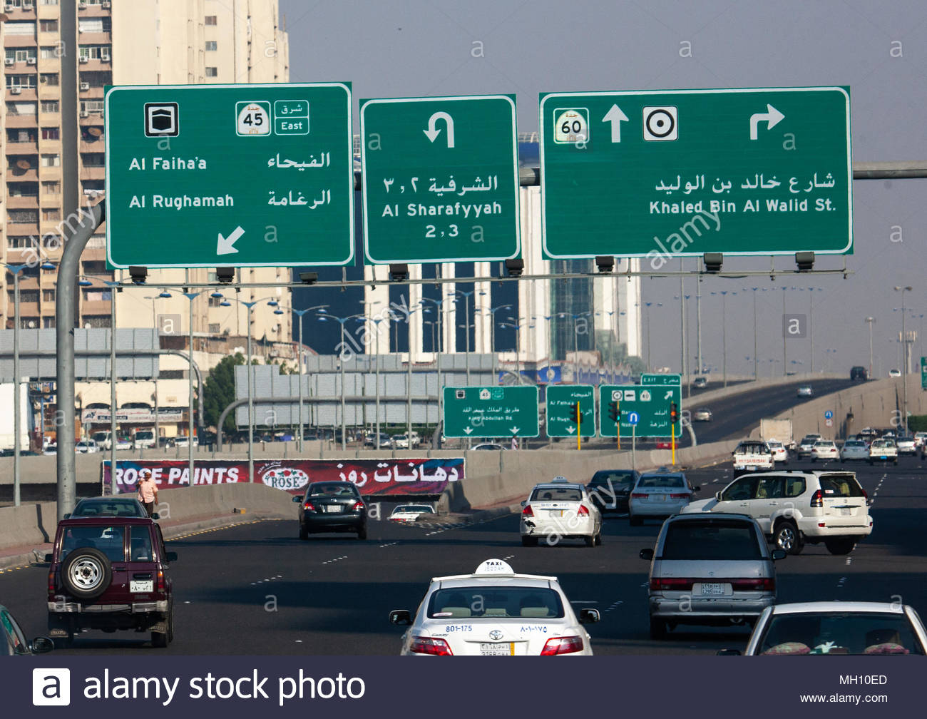
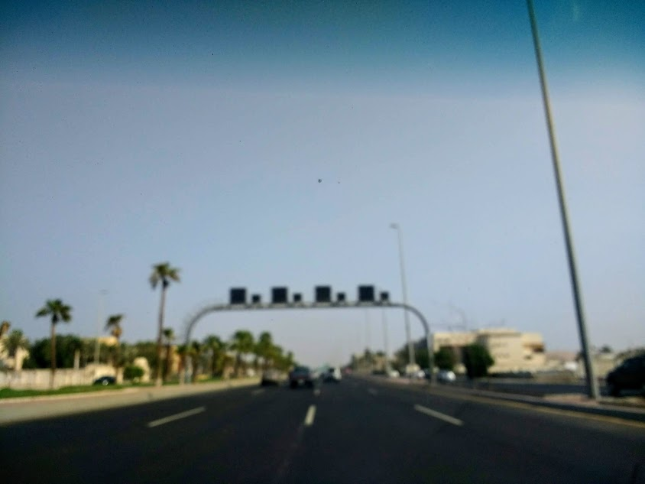
Gap in the Current Traffic Guidance
INFORMATIVE SIGNS: GIVE DIRECTIONS ONLY
LED VMS SCREENS:
- MOST OF THEM
NOT WORKING
- ONLY MESSAGES
& IMAGES
- NO LIVE TRAFFIC
INFO

Slide 8
The Solution / Product
LED Screens displaying Live Traffic Flow using Google Traffic Data Software Interface
Highlighting the type of Traffic condition
Fast
Slow (Congestion)
Too Slow (or Stopped)
Live updates of any incident from Control Room using Internet

Slide 9
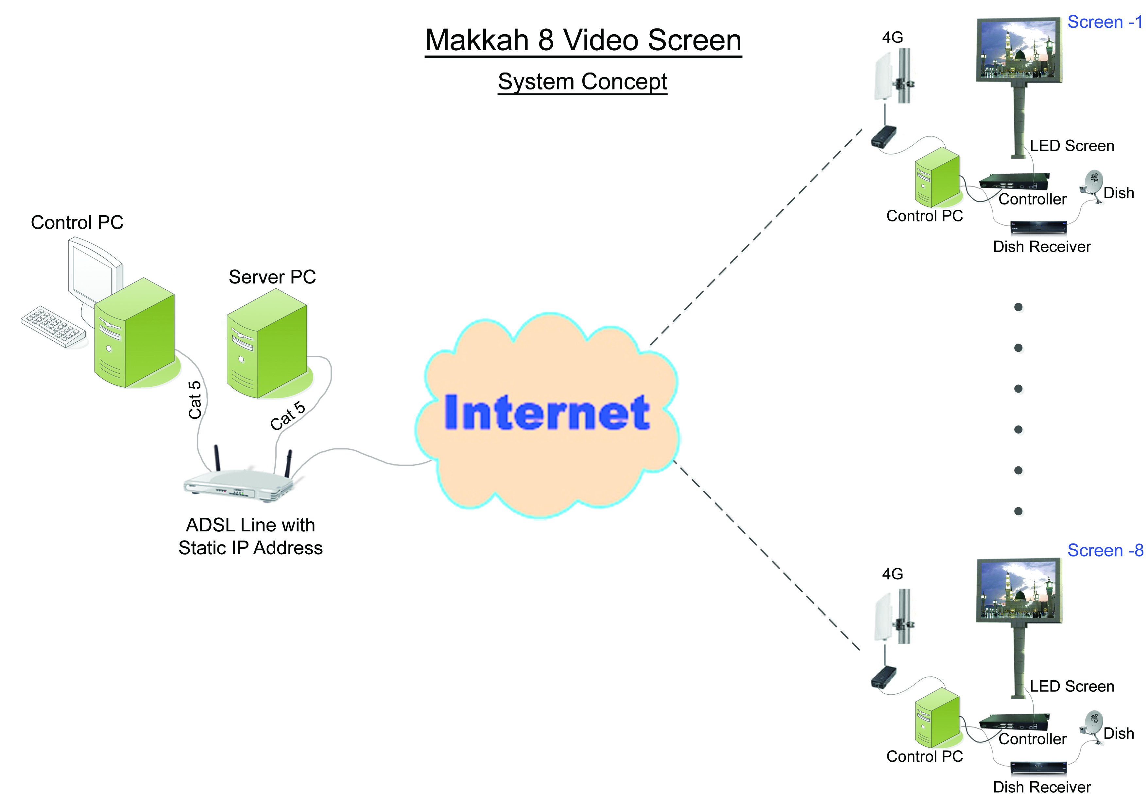
Product: How it works
System Schematic Diagram
Outdoor Equipment
Control Room

Slide 10
Benefits
Live Traffic info.
Avoid using Mobiles while driving
Easy traffic diversions
Reduce accidents and hence fatalities
Reduce congestion on major roads
Reduce fuel wastage due to decongestion
Reduce load on Traffic Police, Ambulance, Civil Defence and other services
Major cost and time savings for all stakeholders

Slide 11
Business Model
Revenue Streams
1. Direct Sales to Govt. Sector
2. Direct Sales to Private Sector
3. Maintenance Contract

Slide 12
The Team
HACKERS HUSTLERS HIPSTERS

Slide 13
Concluding Remarks
Future improvements:
Create a system to verify and validate the data received from Google, Tomtom or other Traffic Data providers
To store the traffic data over a period of time and use AI/ML to make further improvements

Slide 14
Thank you

Slide 15
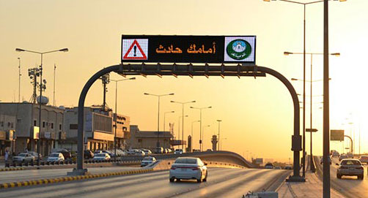
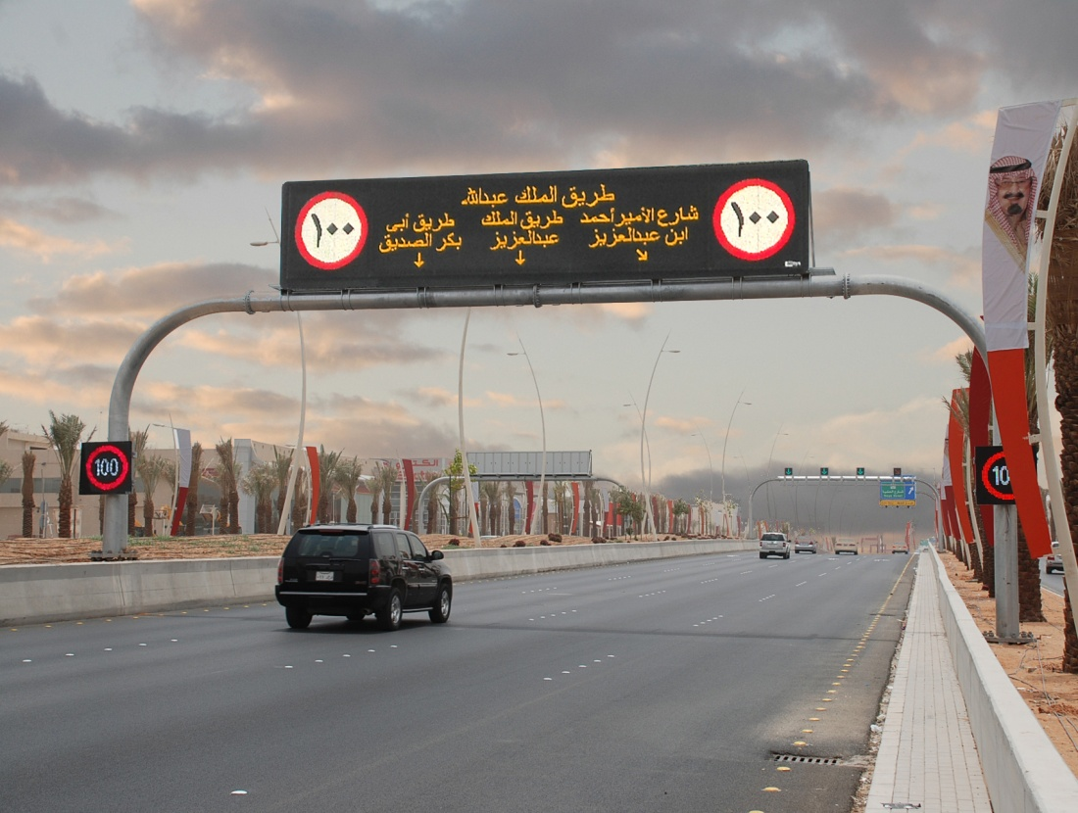

Slide 16
Competition & Differentiation

